Slide 1

Experiment 4: Kettle
Navarro, Rod Geryk C.
CPE160P - 4– A1

Slide 2
OBJECTIVES
To be able to demonstrate how a real kettle works.
2. To be able to apply embedded system in monitoring the boiling point of the water using humidity sensor, an indicator of the boiling point of water using a sound sensor, and turns off the kettle automatically as the water reaches the boiling point using servo motor.
3. To be able to apply what you have learned in Microprocessor and Logic Circuits and Switching Theory.
4. To be able to apply embedded system in a simple handshaking using Arduino Kit.

Slide 3
MATERIALS
Arduino Kit
220 ohm Resistor
LCD
DH11
Servo motor
Buzzer
2 Breadboard
Arduino Uno
Laptop

Slide 4
PROCEDURE
Create a working Humidity and Temperature circuit using Arduino.
Create a working Buzzer and Servo using Arduino.
Create a humidity range in the Arduino IDE.
Debug the code

Slide 5
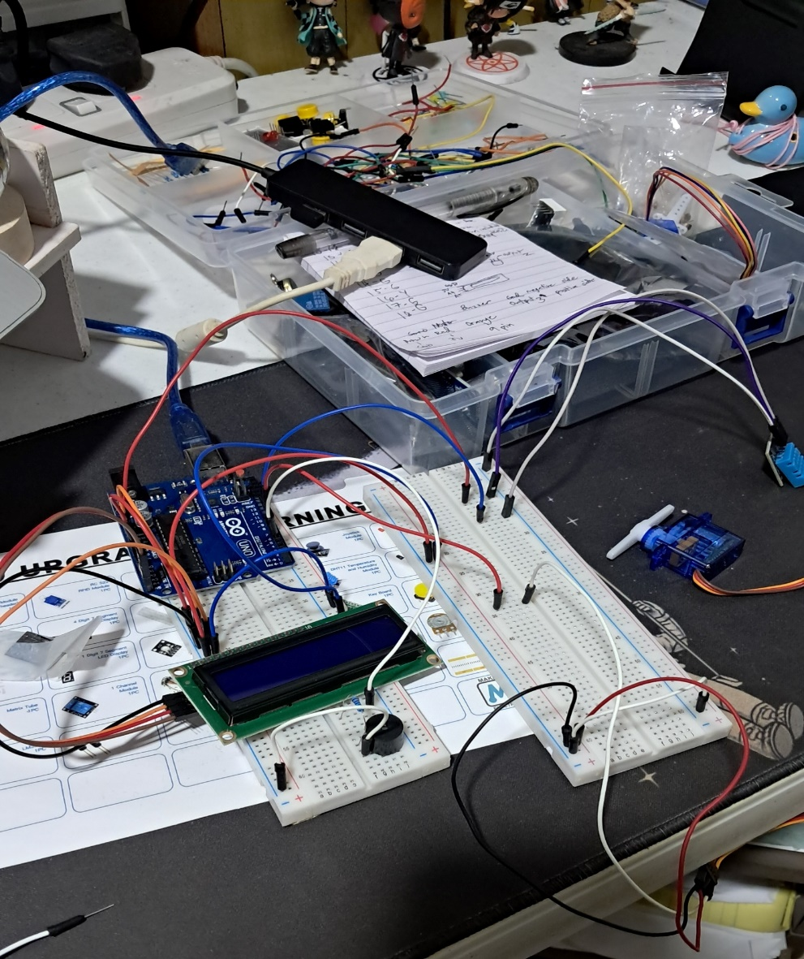
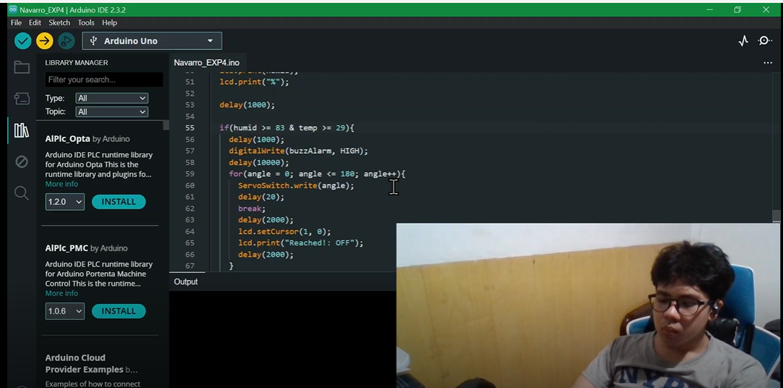
PROCEDURE

Slide 6
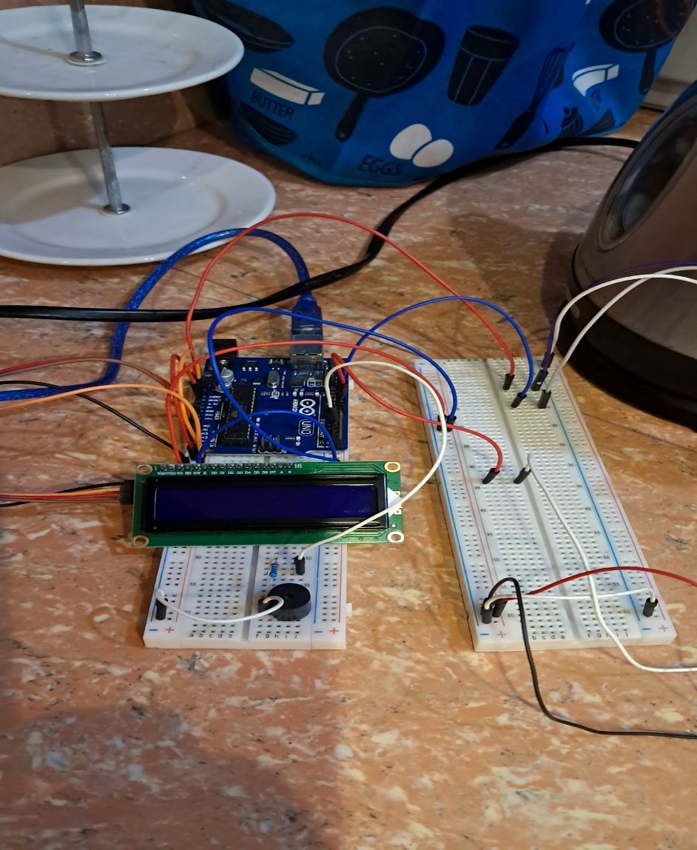
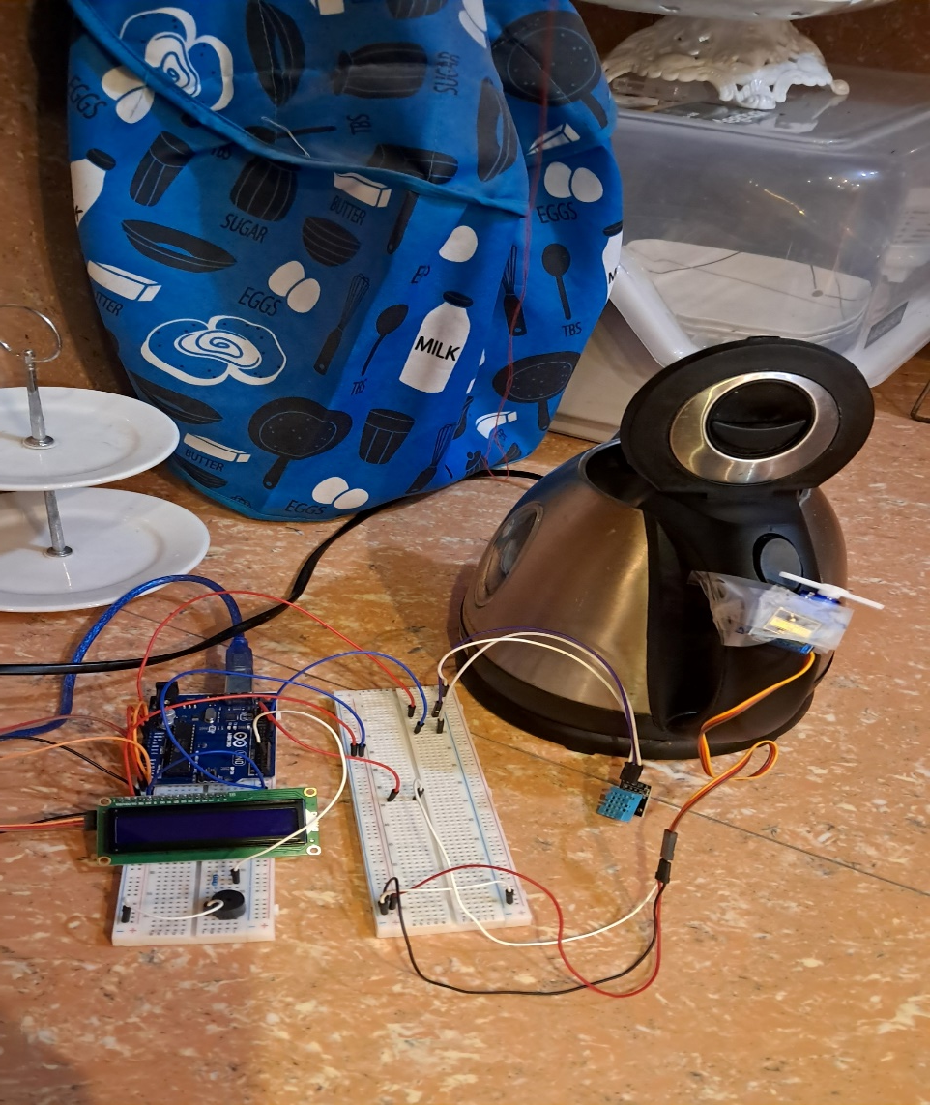
PROCEDURE

Slide 7
THANK YOU!

